Slide 1
Building Machine Learning models with TensorFlow
Data Engineering on Google Cloud Platform
Notes:
Notes:
30 slides + 4 labs: 2.5 hours

Slide 2
Agenda
 | What Is TensorFlow? + Lab
 | TensorFlow for Machine Learning + Lab
 | Gaining more flexibility + Lab
 | Train and evaluate + Lab
‹#›

Slide 3
A tensor is an N-dimensional array of data
Rank 0 Tensor
scalar
Rank 1 Tensor
vector
Rank 2 Tensor
matrix
Rank 3 Tensor
Rank 4 Tensor
Notes:
So where does the name (‘tensorflow’) comes from?
In math, a simple number like 3 or 5 is called a scalar.
A vector is a one-dimensional array of numbers. In physics, a vector is something with magnitude and direction. But in Computer Science, we use vector to mean 1D arrays.
A two-dimensional array is a matrix.
A three-dimensional array? We just call it is a 3D tensor.
So scalar, vector, matrix, 3D Tensor, 4D Tensor, etc.
A tensor is an n-dimensional array of data.
So, your data in TensorFlow are tensors.
They flow through the graph. Hence, TensorFlow.

Slide 4

TensorFlow is an open-source high-performance library for numerical computation
that uses directed graphs
Nodes represent mathematical operations
Edges represent arrays of data
Notes:
TensorFlow is an open-source high-performance library for numerical computation. Not just about machine learning. Any numeric computation. In fact, people have used TensorFlow for all kinds of GPU computing; for example, you can use TensorFlow to solve partial differential equations -- these are useful in domains like fluid dynamics. TensorFlow as a numeric programming library is appealing because you can write your computation code in a high-level language -- Python -- and have it be executed in a fast way.
The way TensorFlow works is that you create a directed graph (a DG) to represent your computation. In this schematic, the nodes represent mathematical operations -- things like adding, subtracting, and multiplying. Also more complex functions. Here, for example, softmax, and matrix-multiplication, etc. are mathematical operations that are part of the directed graph.
Connecting the nodes are the edges. The input and output of the mathematical operations. The edges represent arrays of data. Essentially, the result of computing the cross-entropy is one of the three inputs to the BiasAdd operation, and the output of the BiasAdd operation is sent along to the matrix-multiplication operation (MatMul). The other input to MatMul -- you need two inputs to a matrix multiplication -- the other input is a variable, the weight.
Portable across GPUs, CPUs, mobile ...
Developed at Google
Uses data flow graphs: neural network training and evaluation can be represented as data flow graphs
http://www.tensorflow.org/
GIF: https://www.tensorflow.org/images/tensors_flowing.gif

Slide 5

TensorFlow toolkit hierarchy
Run TF at scale
High-level “out-of-box” API
does distributed training
tf.estimator
Components useful when
building custom NN models
tf.layers, tf.losses, tf.metrics
Python API gives you full control
Core TensorFlow (Python)
Cloud ML Engine
C++ API is quite low-level
Core TensorFlow (C++)
TF runs on different hardware
CPU
GPU
TPU
Android
Notes:
Notes:
Akin to how Java programs run on many different types of hardware because of the JVM. TensorFlow C++ plays the role of the JVM here, providing hardware instruction sets.

Slide 6
TensorFlow toolkit hierarchy
Run TF at scale
High-level “out-of-box” API
does distributed training
tf.estimator
Components useful when
building custom NN models
tf.layers, tf.losses, tf.metrics
Python API gives you full control
Core TensorFlow (Python)
Cloud ML Engine
C++ API is quite low-level
Core TensorFlow (C++)
TF runs on different hardware
CPU
GPU
TPU
Android
Notes:
Notes:
Let’s look at what the Python API does.

Slide 7
The Python API lets you build and run Directed Graphs
a
b
Tensors
...
c = tf.add(a, b)
Build
add
Operations
Run
session = tf.Session()
numpy_c = session.run(c, feed_dict= ….)
c
Notes:
Notes:
So, let’s look at the code on this slide. At first glance, this looks just like, say, numpy.
You want to add two tensors a and b.
So, you write tf.add(a, b)
It returns a tensor c.
Unlike typical Python code, though, running the tf.add() doesn’t execute it. It only builds the DG.
In the DG -- in the directed graph -- a, b and c are tensors. Add is an operation.
In order to run this code, in order to execute the DG, you need to run it. And you run it as part of what is called a Session. So, you say you want the value of c and you ask the session to evaluate c for you.
That’s what runs the DG and you get back a traditional numeric array in Python that contains the values for c.
Programming TensorFlow involves programming a DG. There are two steps.
First step: create a graph.
Second step: run it.
The graph definition is separate from the training loop because this is a lazy evaluation model. It minimizes the Python/C++ context switches and enables the computation to be very efficient. Conceptually, this is like writing a program, compiling it, and then running it on some data. Don’t take the analogy too far, though.There is no explicit compile phase here.
Note that c after you call tf.add is not the actual values -- you have to evaluate c in the context of a TensorFlow session to get a numpy array of values (‘numpy_c’).
Note: We use the term Directed Graph (DG) rather than Directed Acyclic Graph (DAG) because TensorFlow supports cyclic graphs.
For more on this topic:
https://stackoverflow.com/questions/37551389/cyclic-computational-graphs-with-tensorflow-or-theano/37551496#37551496
http://kias.dyndns.org/comath/33.html

Slide 8
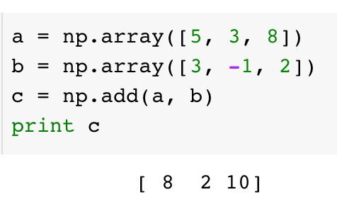
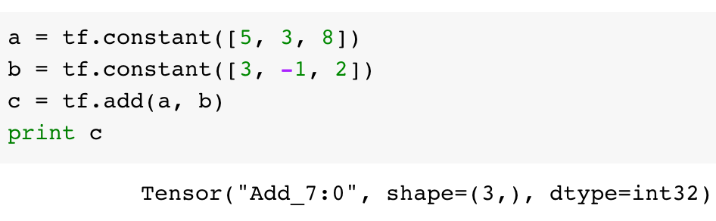
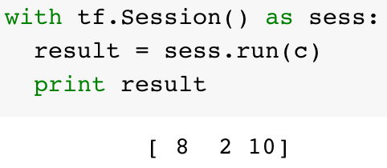
TensorFlow does lazy evaluation: you need to run the graph to get results*
numpy
Tensorflow
Build
*tf Eager, however, allows you to execute operations imperatively
Run
https://github.com/tensorflow/tensorflow/tree/master/tensorflow/python/eager
Notes:
Notes:
So, to reiterate, TensorFlow does lazy evaluation. You write a DG. Then you run the DG in the context of a session to get results. Now, there is a different mode in which you can run TensorFlow, called tf.eager, where the evaluation is immediate and it is not lazy. But eager mode is typically not used in production programs; it’s only for development. We’ll look at tf.eager a little bit later in this course, but for the most part, we’ll focus on the lazy evaluation paradigm. And almost all the code we create and run in production will be in lazy evaluation mode.
In numpy, which is what the majority lion’s share of Python numeric software is written in, a and b are numpy arrays. Numpy gets its speed by being implemented in C. so when you call np.add(), that add gets done in C. But it does get done [is this correct?] when the CPU runs the line of code np.add(a, b) and the numpy array c gets populated with the sums. So, when you print “c”, you get the 8, 2, 10. 8 is the sum of 5 and 3. Add 3 and -1 to get 2. Etc. The point is the np.add() is evaluated immediately.
Unlike with numpy, in TensorFlow c is not the actual values. Instead, c is a tensor -- you have to evaluate c in the context of a TensorFlow session to get a numpy array of values (‘result’).
So, when the CPU or GPU or other whatever hardware evaluates tf.add(a, b), a Tensor gets created in the directed graph, in the DG. But the addition is not carried out until the sess.run() gets called.
So, if we call print c, what gets printed out in the first box is the “debug” output of the Tensor class. It includes a system-assigned unique name for the node in the DG (“ADD_7”) and the shape and data type of the value that will show up when the DG is run.
After the session is run and c is evaluated in the context of the session, we can print the result and we’ll get [8, 2, 10]. So, two stages: a build stage and a run stage.
But why? Why does TensorFlow do lazy evaluation? That’s the next lesson.
https://github.com/tensorflow/tensorflow/tree/master/tensorflow/python/eager

Slide 9
Graphs can be processed, compiled, remotely executed, assigned to devices
Besides computation (e.g. add, matmul), constants, variables, logging, control flow are also Ops
biases
Add
weights
MatMul
recv
send
examples
‹#›
Notes:
Notes:
Example of each mentioned use-case:
Processed -- add quantization or data types, add debug nodes; create summaries to write values out so that Tensorboard can read ...
Compiled -- fuse ops to improve performance. For example, two consecutive add nodes can be fused into a single one.
Remotely executed, assigned to devices -- note colors, several parts of the graph can be on different devices, doesn’t matter whether GPU or several computers. Automatically insert send/recv nodes.

Slide 10
TensorFlow can distribute computation
Bindings + Compound Ops
...
Python front end
Core TensorFlow Execution System
Ops
add
mul
Print
reshape
...
CPU
GPU
Android
iOS
...
Kernels
‹#›
Notes:
Notes:
One key benefit of this model -- to be able to distribute computation across many machines, and many types of machines. No need to assign a Print op to a GPU.

Slide 11
Lab 2: Getting Started with TensorFlow
Serverless Machine Learning
In this lab you will:
Explore the TensorFlow Python API
Building a graph
Running a graph
Feeding values into a graph
Find area of a triangle using TensorFlow
‹#›

Slide 12
Agenda
 | TensorFlow for Machine Learning + Lab
‹#›

Slide 13
TensorFlow toolkit hierarchy
Run TF at scale
High-level “out-of-box” API
does distributed training
tf.estimator
Components useful when
building custom NN models
tf.layers, tf.losses, tf.metrics
Python API gives you full control
Core TensorFlow (Python)
Cloud ML Engine
C++ API is quite low-level
Core TensorFlow (C++)
TF runs on different hardware
CPU
GPU
TPU
Android
Notes:
Notes:
Let’s look at what the Python API does.

Slide 14
Working with Estimator API
Set up machine learning model
Regression or classification?
What is the label?
What are the features?
Carry out ML steps
Train the model
Evaluate the model
Predict with the model
ML Model
Square
Footage
PRICE
‹#›
Notes:
Notes:
Two parts to it. One is static -- how to set the ML problem up.
The second is the ML steps you carry out.
Imagine that you want to create a ML model to predict cost of a house given the sq footage. Answer the first three questions.

Slide 15
The structure of an Estimator API ML model
import tensorflow as tf
#Define input feature columns
featcols = [
tf.feature_column.numeric_column("sq_footage") ]
#Instantiate Linear Regression Model
model = tf.estimator.LinearRegressor(featcols, './model_trained')
#Train
def train_input_fn():
features = {
"sq_footage": tf.constant([1000, 2000]) }
labels = tf.constant([50, 100]) # in thousands
return features, labels
model.train(train_input_fn, steps=100)
#Predict
def pred_input_fn():
features = {
"sq_footage": tf.constant([1500, 1800]) }
return features
out = trained.predict(pred_input_fn)
ML Model
Square
Footage
PRICE
‹#›
Notes:
Notes:
Conceptually, square footage shows up twice. Once as the placeholder (“feature_column”) and next as an input feed (“input_fn”).

Slide 16
Steps to define an Estimator API model
import tensorflow as tf
#Define input feature columns
featcols = [
tf.feature_column.numeric_column("sq_footage") ]
#Instantiate Linear Regression Model
model = tf.estimator.LinearRegressor(featcols, './model_trained')
#Train
def train_input_fn():
features = {
"sq_footage": tf.constant([1000, 2000]) }
labels = tf.constant([50, 100]) # in thousands
return features, labels
model.train(train_input_fn, steps=100)
#Predict
def pred_input_fn():
features = {
"sq_footage": tf.constant([1500, 1800]) }
return features
out = trained.predict(pred_input_fn)
1. Set up feature Column
(other types exist: we'll look at them in later Chapter)
2. Create a model, passing in the feature COLUMNS
3. Write Input_Fn (returns Features, Labels)
Features is a DICT
‹#›

Slide 17
Steps to do Machine Learning with model
import tensorflow as tf
#Define input feature columns
featcols = [
tf.feature_column.numeric_column("sq_footage") ]
#Instantiate Linear Regression Model
model = tf.estimator.LinearRegressor(featcols, './model_trained')
#Train
def train_input_fn():
features = {
"sq_footage": tf.constant([1000, 2000]) }
labels = tf.constant([50, 100]) # in thousands
return features, labels
model.train(train_input_fn, steps=100)
#Predict
def pred_input_fn():
features = {
"sq_footage": tf.constant([1500, 1800]) }
return features
out = trained.predict(pred_input_fn)
4. Train the model
5. USE trained model to predict
‹#›
Notes:
Notes:
estimator.predict() returns a generator function, not the actual values. You have to iterate through it to get the values. Or use list() to get all the values in one go.

Slide 18
Beyond linear regression with Estimators
Deep neural network
Classification
model = DNNRegressor(feature_columns=[...],
hidden_units=[128, 64, 32])
model = LinearClassifier(feature_columns=[...])
model = DNNClassifier(feature_columns=[...], hidden_units=[...])
‹#›
Notes:
Notes:
The hourglass indicates that we’ll cover this later in the course.
https://pixabay.com/en/hourglass-sandglass-patience-time-297765/ (cc0)

Slide 19
Lab 3: Machine Learning using tf.estimator
Serverless Machine Learning
In this lab you will:
Read from Pandas Dataframe into tf.constant
Create feature columns for estimator
Linear Regression with tf.Estimator framework
Deep Neural Network regression
Benchmark dataset
‹#›
Notes:
Notes:
It’s easy to ML --- just write 4 lines of Python code, throw some data into the hopper and voila!
But wait … the ML model doesn’t perform that well. More effort is needed.
If you are curious about why the ML model is performing so poorly: the problem is nonlinear in the inputs, but we are not scaling the inputs, and so the optimizer is not able to find the optimal weights. Also, the form of the solution requires some feature engineering on the raw inputs. Some preprocessing and feature engineering will enable us to get to better performance -- it’s important to realize that if you don’t do the necessary legwork, just making the model more complex is not going to work.
(the .csv files have on the order of 7700 samples, which should be enough for the models we are trying, so it’s not a case of not having enough data).

Slide 20
Agenda
 | Gaining more flexibility + Lab
‹#›

Slide 21



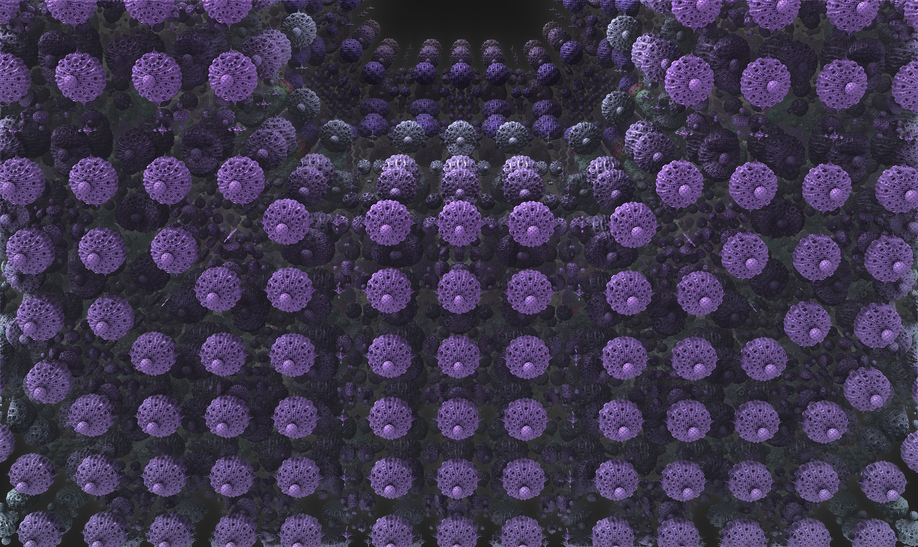
What’s left? Ways to build effective ML
Big Data
Feature Engineering
Model Architectures
‹#›
Notes:
Notes:
https://pixabay.com/en/large-data-dataset-word-895563/ (cc0)
https://pixabay.com/en/fractal-complexity-render-3d-1232494/ (cc0)
https://pixabay.com/en/robot-artificial-intelligence-woman-507811/ (cc0)
Now that you know *how* to build ML, let’s learn how to do it well in the rest of the course.
Ordered from easiest to most difficult.
Before we can do that though, we need to refactor our simple TensorFlow model.

Slide 22

We need to refactor our Estimator model
Read out of memory Data
Add new features easily
EVAluate as part of training
Big Data
Feature Engineering
Model Architectures
‹#›
Notes:
Notes:
Refactor == improve design of model without adding any new capability. That’s what we are going to do in the next two labs.
To handle big data, we need to be able to read out-of-memory datasets.
To do feature engineering, we need to be able add new feature columns easily.
To try out new model architectures, we have to move evaluation as a bonafide part of training, so that we can test other architectures systematically.

Slide 23
TensorFlow toolkit hierarchy
Run TF at scale
High-level “out-of-box” API
does distributed training
tf.estimator
Components useful when
building custom NN models
tf.layers, tf.losses, tf.metrics
Python API gives you full control
Core TensorFlow (Python)
Cloud ML Engine
C++ API is quite low-level
Core TensorFlow (C++)
TF runs on different hardware
CPU
GPU
TPU
Android
Notes:
Notes:
We’ll use the next lower level down in refactoring.

Slide 24
To read sharded CSV files, create a TextLineDataset giving it a function to decode the CSV into features, labels
CSV_COLUMNS = ['amount','pickuplon','pickuplat','dropofflon','dropofflat','passengers']
LABEL_COLUMN = 'amount'
DEFAULTS = [[0.0], [-74.0], [40.0], [-74.0], [40.7], [1.0]]
def read_dataset(filename, mode, batch_size=512):
def decode_csv(value_column):
columns = tf.decode_csv(value_column, record_defaults=DEFAULTS)
features = dict(zip(CSV_COLUMNS, columns))
label = features.pop(LABEL_COLUMN)
return features, label
dataset = tf.data.TextLineDataset(filename).map(decode_csv)
...
return ...
Notes:
Code for reading a CSV file
Directly supports a list of filenames if you have sharded files

Slide 25
Repeat the data and send it along in chunks
def read_dataset(filename, mode, batch_size=512):
...
dataset = tf.data.TextLineDataset(filename).map(decode_csv)
if mode == tf.estimator.ModeKeys.TRAIN:
num_epochs = None # indefinitely
else:
num_epochs = 1 # end-of-input after this
dataset = dataset.repeat(num_epochs).batch(batch_size)
return dataset.make_one_shot_iterator().get_next()
Notes:
Code for reading a CSV file
Directly supports a list of filenames if you have sharded files

Slide 26
Lab 4: Refactoring to add batching and feature-creation
Serverless Machine Learning
In this lab you will:
Refactor the input
Refactor the way the features are created
Create and train the model
Evaluate model
‹#›

Slide 27
Agenda
 | Train and evaluate + Lab
‹#›

Slide 28


We need to make our ML pipeline more robust
In our Estimator examples so far, we:
1. ran the training_op for num_steps or num_epochs iterations
2. saved checkpoints during training
3. Used final checkpoint as model
For realistic, real-world ML models, we need to:
1. Use a fault-tolerant distributed training framework
2. Choose model based on validation dataset
3. Monitor training, especially if it will take days
4. Resume training if necessary
‹#›
Notes:
Notes:
https://pixabay.com/en/hang-out-plush-toys-kermit-1521663/ (cc0)
https://pixabay.com/en/london-england-hdr-boats-ships-123778/ (cc0)
Our tf.learn examples have been a toy and is okay if the only thing we are going to be handling are plush-toys. We can’t just hang a clothesline and call it a bridge. In the real world, we need to make things more robust.
Monitoring: Experiment will export summaries, so that we can see them in TensorBoard.

Slide 29
Shuffling is important for distributed training
def read_dataset(filename, mode, batch_size=512):
...
dataset = tf.data.TextLineDataset(filename).map(decode_csv)
if mode == tf.estimator.ModeKeys.TRAIN:
num_epochs = None # indefinitely
dataset = dataset.shuffle(buffer_size=10*batch_size)
else:
num_epochs = 1 # end-of-input after this
dataset = dataset.repeat(num_epochs).batch(batch_size)
return dataset.make_one_shot_iterator().get_next()
Notes:
This is so that different workers don’t see the same data in the same order.

Slide 30
Estimator comes with a method that handles distributed training and evaluation
estimator = tf.estimator.LinearRegressor(
model_dir=output_dir,
feature_columns=feature_cols)
...
tf.estimator.train_and_evaluate(estimator,
train_spec,
eval_spec)
Distribute the graph
Share variables
Evaluate every once in a while
Handle machine failures
Create checkpoint files
Recover from failures
Pass in:
Estimator
Train Spec
Eval Spec
Save summaries for TensorBoard
Notes:
Which begs the question … what is a train-spec and eval-spec?

Slide 31
The TrainSpec consists of the things that used to be passed into the train() method
Train_spec = tf.estimator.TrainSpec(
input_fn=read_dataset('gs://.../train*',
mode=tf.contrib.learn.ModeKeys.TRAIN),
max_steps=num_train_steps)
...
tf.estimator.train_and_evaluate(estimator, train_spec, eval_spec)
Think “steps”, not “epochs” with production-ready, distributed models.
1. gradient updates from slow workers could get ignored
2. When retraining a model with fresh data, we’ll resume from earlier number of steps (and corresponding hyper-parameters)

Slide 32
The EvalSpec controls the evaluation and the checkpointing of the model since they happen at the same time
exporter = ...
eval_spec=tf.estimator.EvalSpec(
input_fn=read_dataset('gs://.../valid*',
mode=tf.contrib.learn.ModeKeys.EVAL),
steps=None,
start_delay_secs=60, # start evaluating after N seconds
throttle_secs=600, # evaluate every N seconds
exporters=exporter)
tf.estimator.train_and_evaluate(estimator, train_spec, eval_spec)
Notes:
The way it works is that the training loop saves the model into a checkpoint
The eval loop restores the model from the checkpoint and uses it to evaluate the model.
So checkpointing is needed for evaluation.
But when we checkpoint, we want to make sure that the model we save is complete and can be used for prediction …
Because it is possible that in the steps that follow, the model will start to overfit.
In that case, we’ll want to use the current checkpoint as the best model.
Hence, we think of checkpointing as “exporting” and we’ll use an exporter to do this.

Slide 33
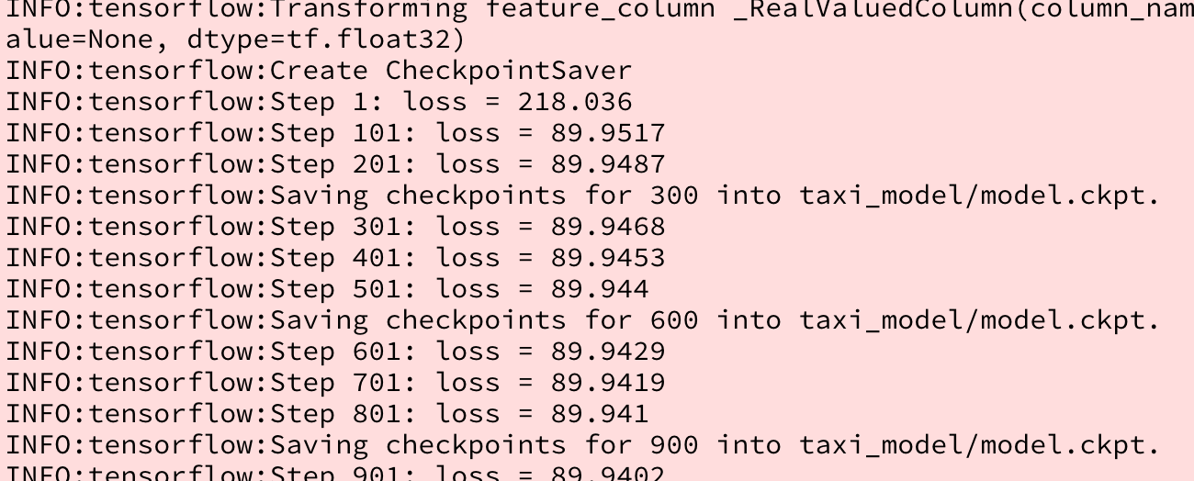
Change logging level from WARN
tf.logging.set_verbosity(tf.logging.INFO)
‹#›
Notes:
Notes:
The default is WARN; change it to INFO to see logs as TF trains.
The levels are DEBUG, INFO, WARN, ERROR, and FATAL.

Slide 34
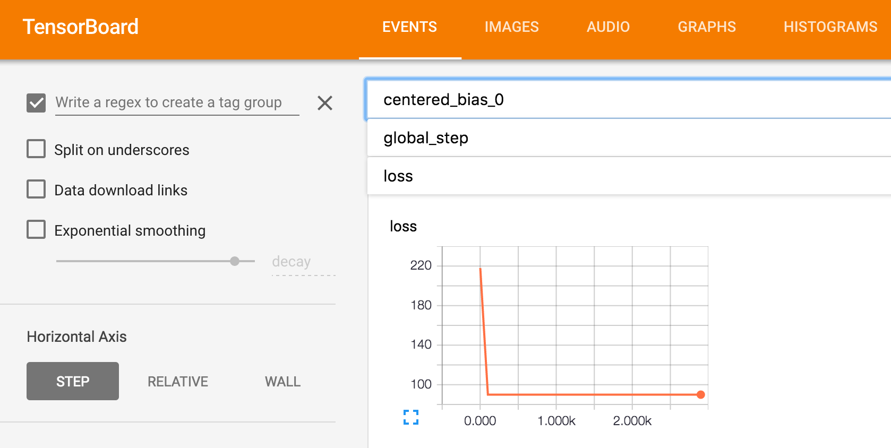
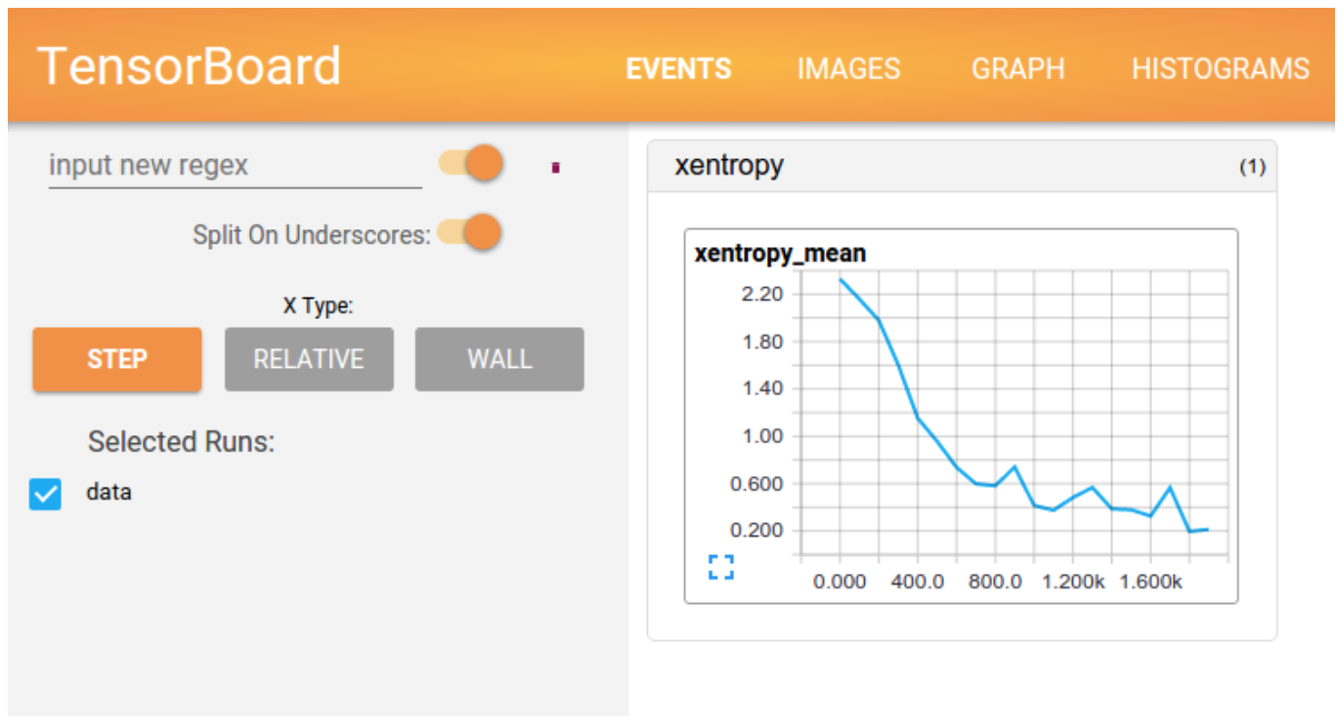
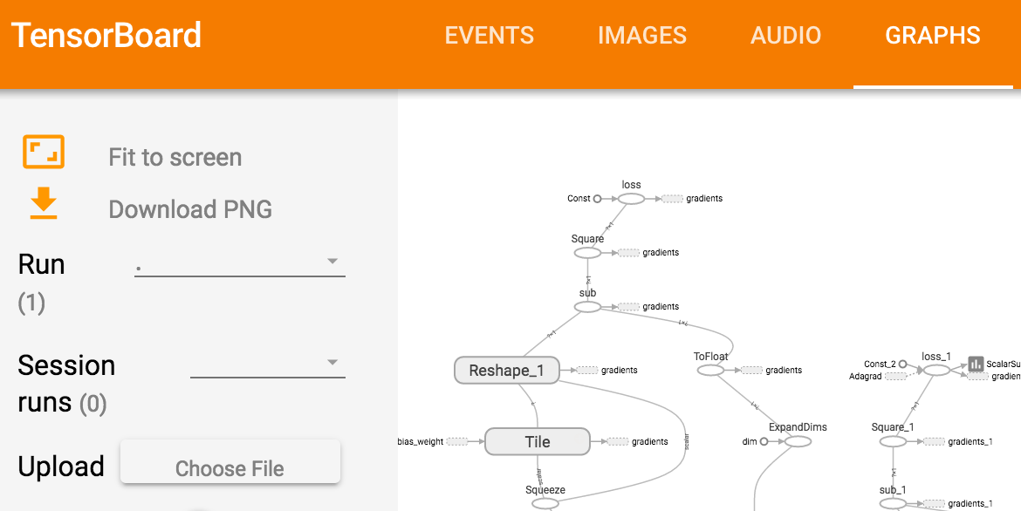
Use TensorBoard to monitor training
Loss
Data
Model
‹#›
Notes:
Notes:
TensorBoard is a collection of visualization tools designed specifically to help you visualize TensorFlow.
TensorFlow graph
Plot quantitative metrics
Pass and graph additional data
Events at top left shows “loss”.
Graphs at bottom right shows the linear model graph as built by TensorFlow.
Point TensorBoard at model output directory.
https://www.tensorflow.org/programmers_guide/summaries_and_tensorboard

Slide 35
Lab 5: Distributed training and monitoring
Serverless Machine Learning
In this lab you will:
Create features out of input data
Train and evaluate
Monitor with Tensorboard
‹#›

Slide 36
Resources
tf.contrib.learn API | https://www.tensorflow.org/versions/master/api_docs/python/contrib.learn.html
TensorFlow (all) | https://www.tensorflow.org/api_docs/python/index.html
Understanding neural networks with TensorFlow playground | https://cloud.google.com/blog/big-data/2016/07/understanding-neural-networks-with-tensorflow-playground
TensorFlow examples | https://github.com/aymericdamien/TensorFlow-Examples
TensorFlow MNIST | https://www.youtube.com/watch?v=vq2nnJ4g6N0&t=3686s
Another TF Datalab | https://github.com/kazunori279/TensorFlow-Intro/
‹#›

Slide 37
Images by Connie Zhou

